Slide 1
DIGITAL PORTFOLIO
Name: Gopika S
Register Number: 22924uo9014
Naan Mudhalvan ID: 6C13B773057F030874241F72AC
Department: BCA (Bachelor of Computer Application)
College: Sri Bharathi Women’s arts and Science College University: Thiruvalluvar University

Slide 2
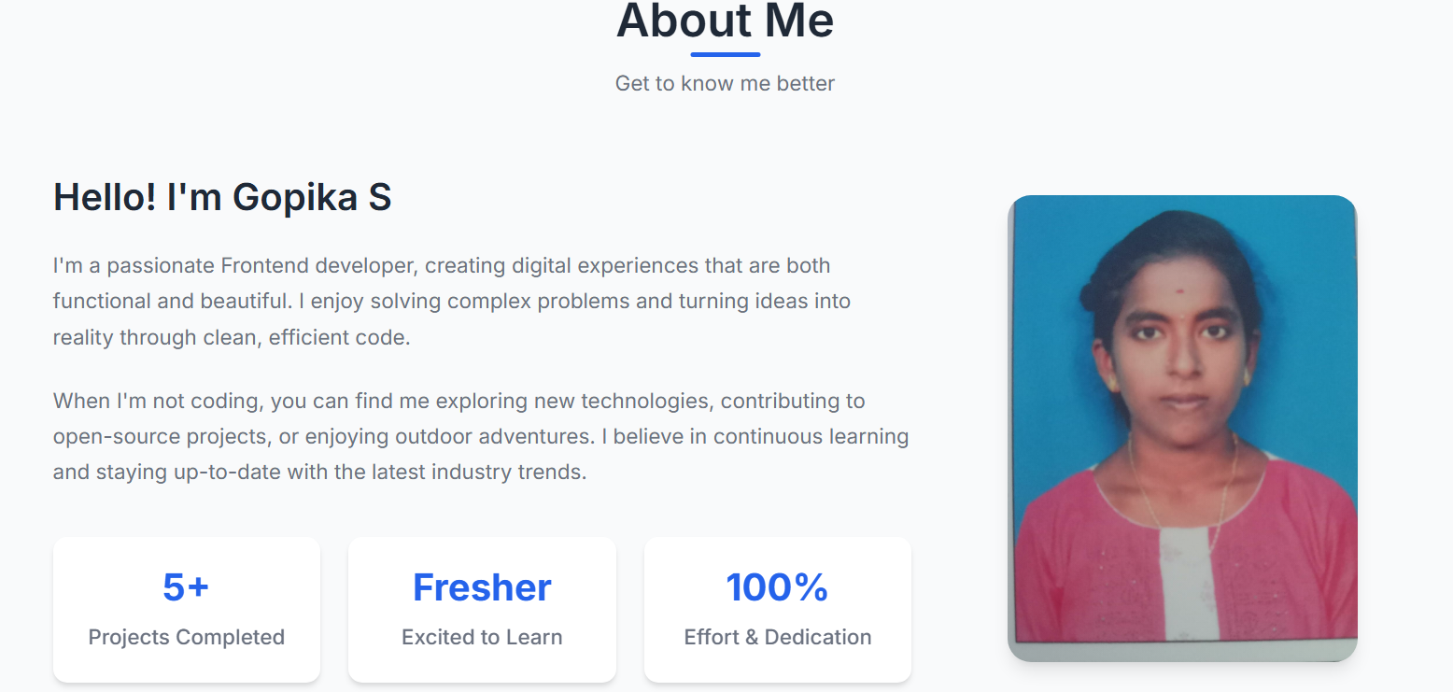

Slide 3
Agenda
Problem Statement
Project Overview
End Users
Tools and Technologies
Portfolio Design and Layout
Features and Functionality
Results and Screenshots
Conclusion
GitHub Link

Slide 4
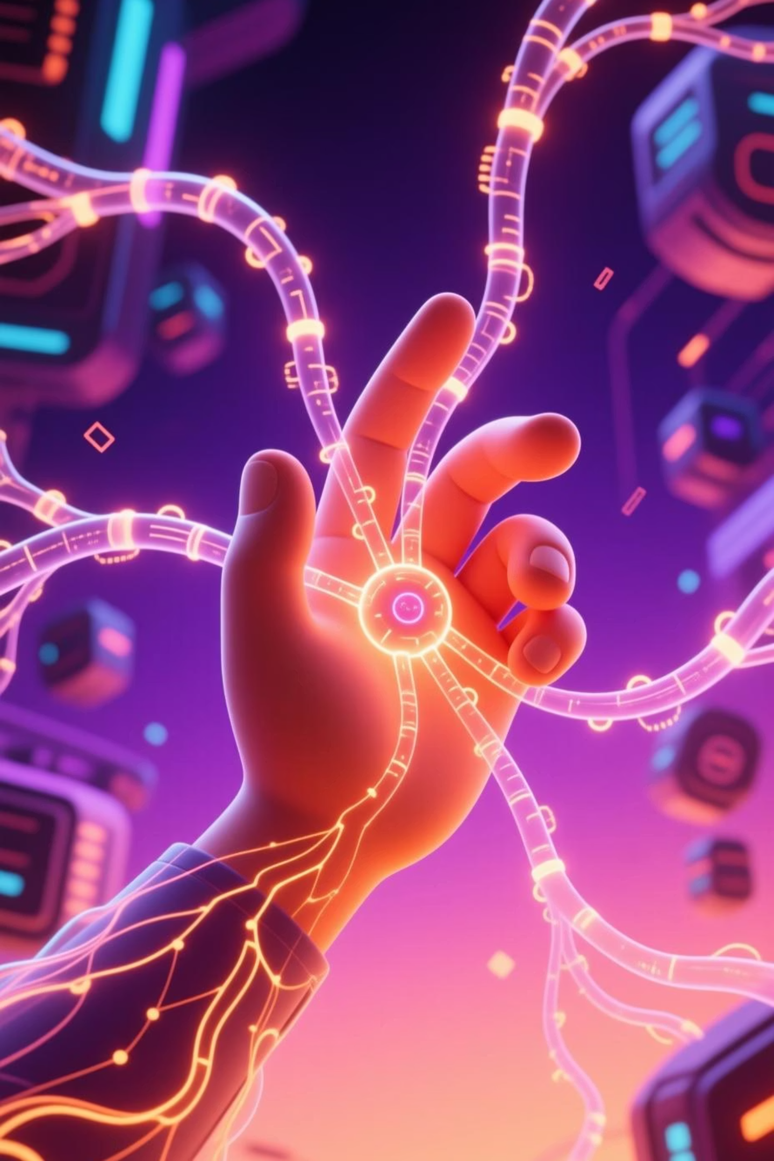
Generative AI: Transforming Creativity and Work in 2025
Welcome to an exploration of how Generative AI is reshaping our world, enhancing productivity, and unlocking new frontiers of creative potential.
Presented By Gopika S

Slide 5
Problem Statement
Traditional AI systems rely heavily on predefined rules and labeled datasets, limiting creativity and adaptability. There is a growing need for systems that can generate new, original, and human-like content such as text, images, music, and code.
Traditional AI is mostly predictive, not creative.
Industries need original outputs (images, text, designs) instead of just classification.
Manual creative processes are time-consuming and expensive.Generative AI solves this gap by producing new and meaningful content automatically.

Slide 6
Project Overview
Generative AI uses deep learning models to create human-like outputs.
It is powered by architectures like GANs, Transformers, and Diffusion models.
Applications:
Text → Summaries, reports
chatbotsImages → Artwork, ads, medical imaging
Audio → Music, voice cloning
Video → Animation, movie editing

Slide 7
End Users
Education Sector: Helps students with personalized learning.
Entertainment Industry: Generates scripts, songs, and visuals.
Healthcare: Creates synthetic data for medical research.
Marketing Teams: Designs personalized campaigns.
Software Developers: Autocomplete, debugging, code generation.

Slide 8
Tools and Technologies
Frameworks: TensorFlow, PyTorch, KerasPretrained
Models: GPT, DALL·E, Stable Diffusion, BERT
Languages: Python, JavaScript, R
Platforms: Google Colab, AWS SageMaker, Hugging Face

Slide 9
Portfolio Design and Layout
Intro Page – Title, project purpose, and team info
Demo Section – User gives input prompt → AI generates text/image
Comparison Panel – AI vs Human-generated outputs
Use Case Section – Real-world applications explained
About/Contact Section – References & contributors

Slide 10
Features and Functionality
Text Generator – Articles, poetry, or summaries
Image Generator – Art, logos, product designs
Code Assistant – Suggests and fixes code
AI Chatbot – Contextual conversations
Content Personalization – Tailored results for each user

Slide 11
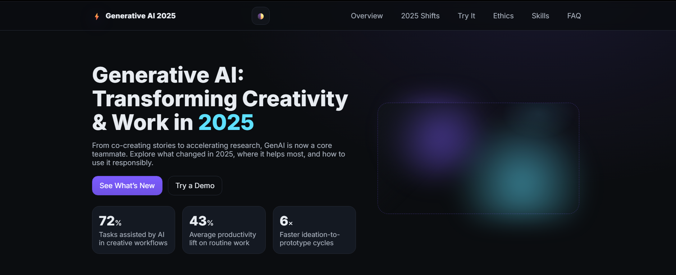
Results and Screenshots

Slide 12
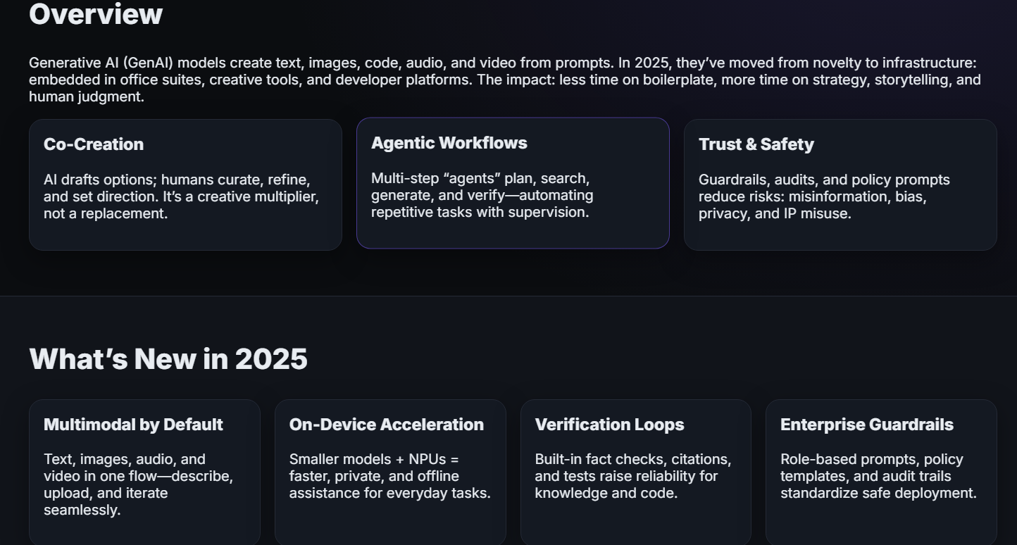
Results and Screenshots

Slide 13
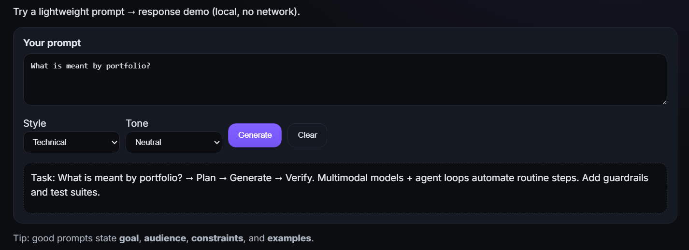
Results and Screenshots

Slide 14
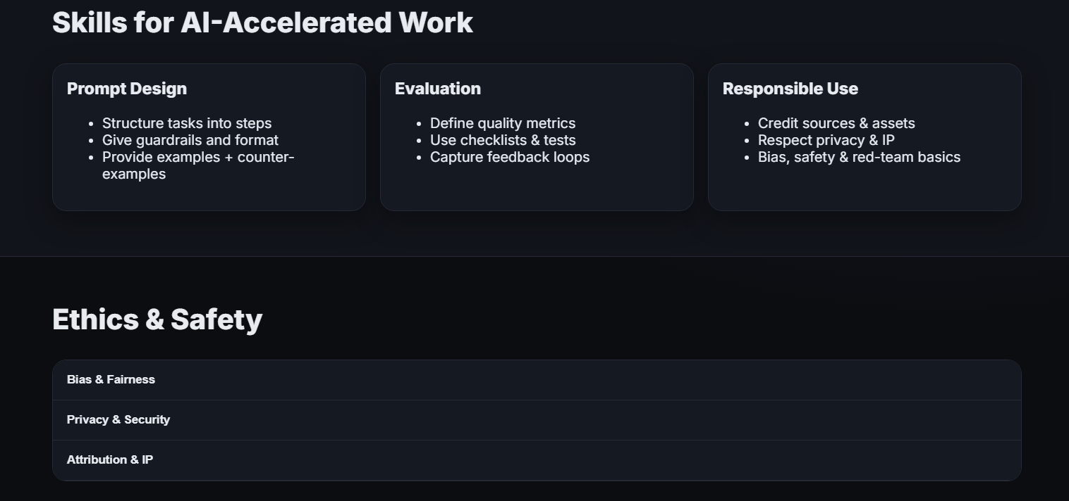
Results and Conclusions

Slide 15
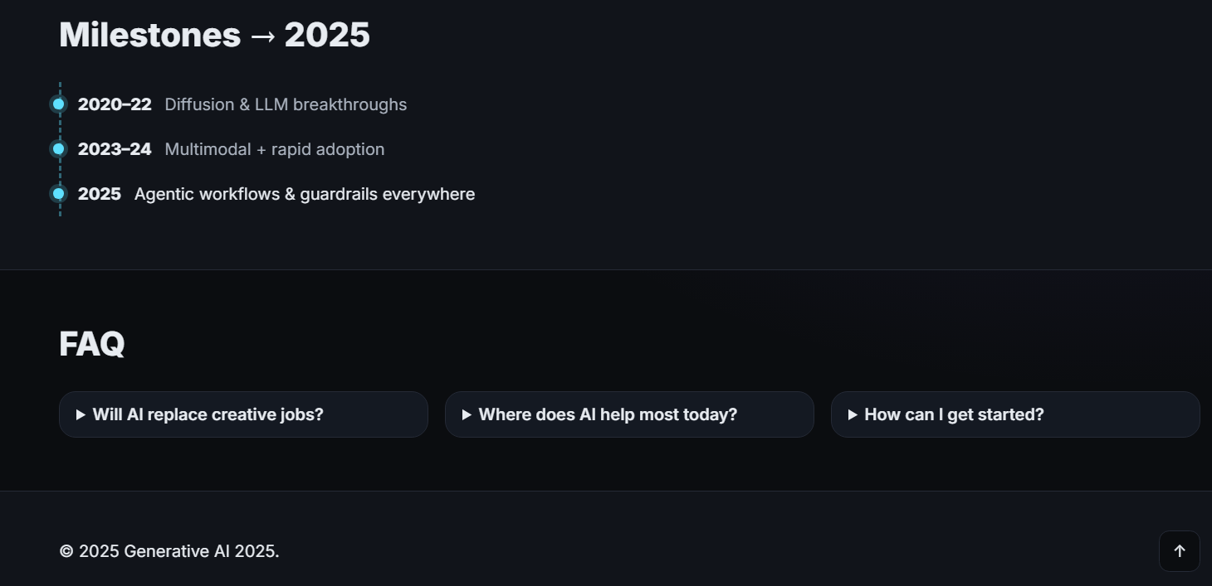
Results and Screenshots

Slide 16
Conclusion
Generative AI is rapidly transforming the way we create and interact with technology by enabling machines to produce human-like text, images, music, and even code. It not only enhances creativity but also improves productivity by reducing the time taken to move from an idea to a final output. From personalized learning and medical research to design, entertainment, and business applications, Generative AI is opening up opportunities across diverse industries. However, while it brings immense potential, it also raises challenges related to ethics, bias, and misuse that must be carefully addressed. With responsible development and deployment, Generative AI will continue to evolve as a powerful tool that bridges imagination and innovation, shaping the future of work and creativity.
GitHub Link
Live Link: https://gopika000-tech.github.io/Digital-Portfolio/
GitHub Repo: https://github.com/gopika000-tech/Digital-Portfolio

Slide 17
Thank You!

